Slide 1
Ionic and Covalent Bonding
Ionic Bonds
Describing Ionic Bonds
Electron Configurations of Ions
Ionic Radii
Covalent Bonds
Describing Covalent Bonds
Polar Covalent Bonds; Electronegativity
Writing Lewis Electron-Dot Formulas
Delocalized Bonding: Resonance
Exceptions to the Octet Rule
Formal Charge and Lewis Formulas
Bond Length and Bond Order
Bond Energy

Slide 2
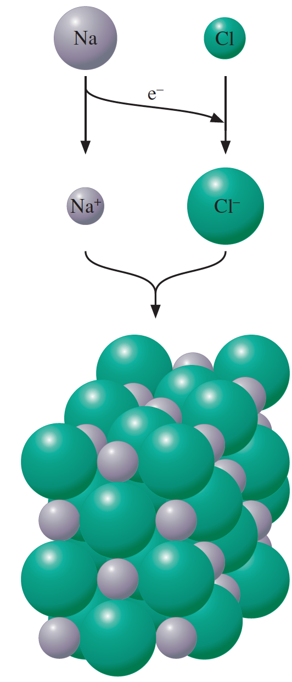
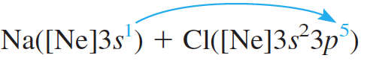
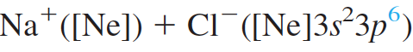
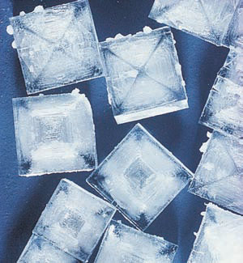
Ionic Bonds
An ionic bond is a chemical bond formed by the electrostatic attraction between positive and negative ions.
NaCl Crystal

Slide 3
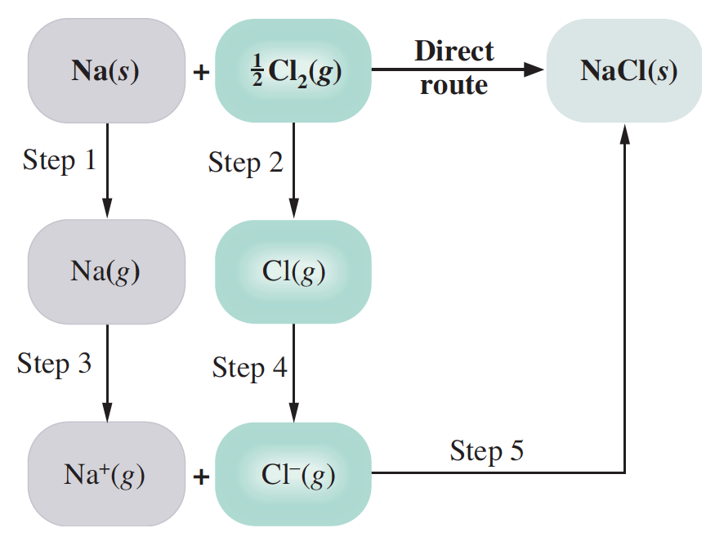
Lattice Energies from the Born–Haber Cycle
The lattice energy is the change in energy that occurs when an ionic solid is separated into isolated ions in the gas phase. For sodium chloride, the process is
1. Sublimation of sodium: 108 kJ/mole
2. Dissociation of chlorine: 120 kJ/mole
3. Ionization of sodium: 496 kJ/mole
4. Formation of Cl– ion: – 349 kJ/mole
5. Formation of NaCl(s) from ions: negative of the lattice energy. If we let U be the lattice energy, the enthalpy change for Step 5 is –U.

Slide 4
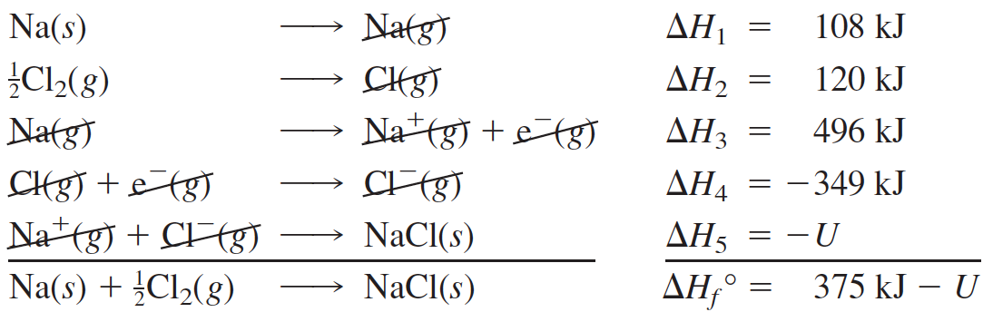
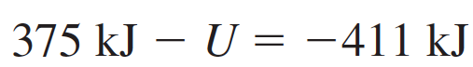
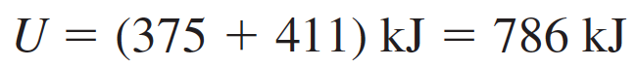
Lattice Energies from the Born–Haber Cycle
Lattice Energy,

Slide 5
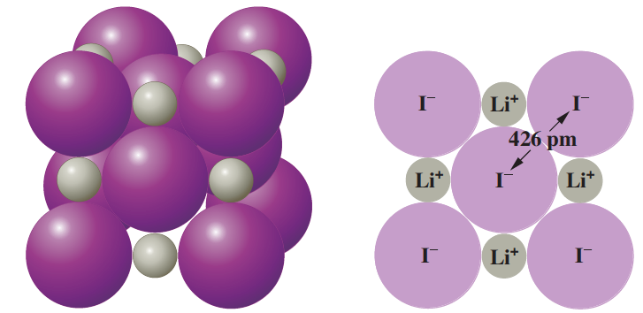
Ionic Radii
The ionic radius is a measure of the size of the spherical region around the nucleus of an ion within which the electrons are most likely to be found.
The distance between iodine nuclei (426 pm) is determined experimentally. One-half of this distance (213 pm) equals the iodide ion radius.

Slide 6
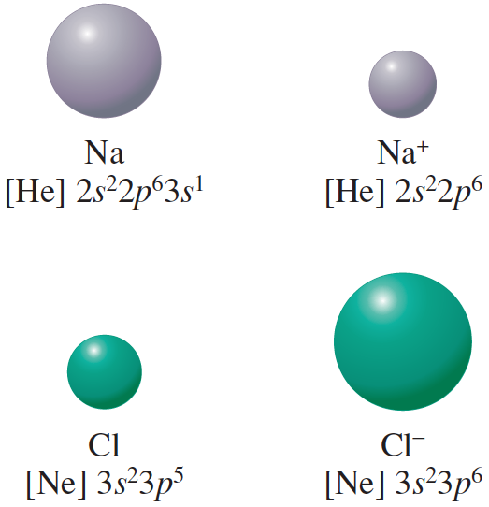
Comparison of atomic and ionic radii
Sodium atom loses its outer
shell in forming the Na⁺ ion. Thus, the cation is smaller than the atom.
The Cl– ion is larger than the Cl atom, because the same nuclear charge holds a greater number of electrons less strongly
Which has the larger radius, S or S^{2–}? Explain.
Which has the larger radius, Mg or Mg²⁺? Explain.

Slide 7
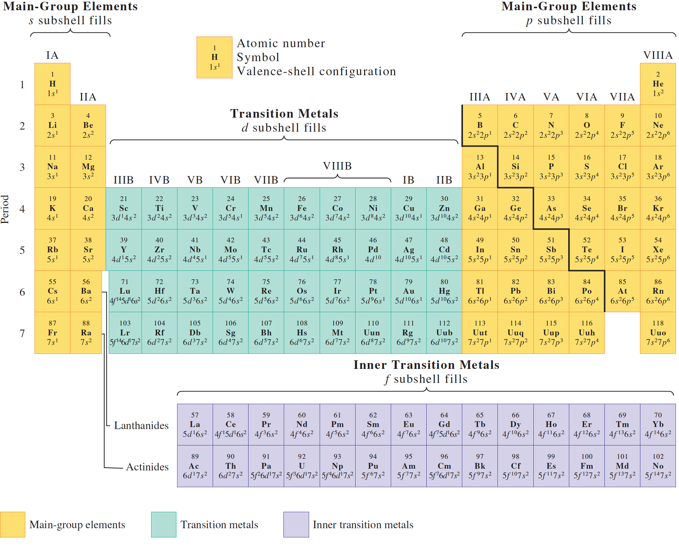
Arrange the following ions in order of increasing ionic radius: Sr²⁺, Mg²⁺, Ca²⁺.

Slide 8
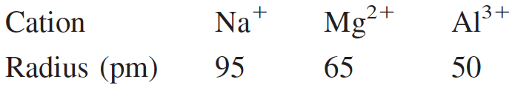
Isoelectronic Species
All of these ions have the neon configuration 1s²2s²2p⁶ but different nuclear charges; that is, they are isoelectronic. Isoelectronic refers to different species having the same number and configuration of electrons.
To understand the decrease in radius from Na⁺ to Al³⁺, imagine the nuclear charge (atomic number) of Na⁺ to increase. With each increase of charge, the orbitals contract due to the greater attractive force of the nucleus. Thus, in any isoelectronic sequence of atomic ions, the ionic radius decreases with increasing atomic number.

Slide 9
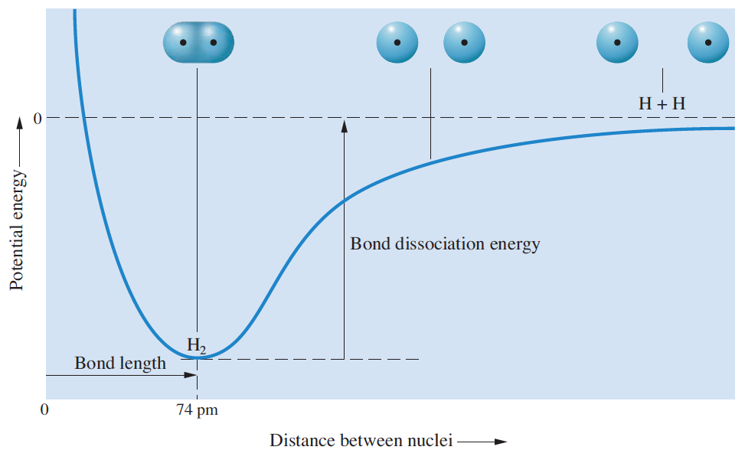
Potential-energy curve for H₂

Slide 10
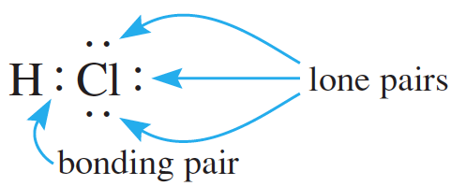
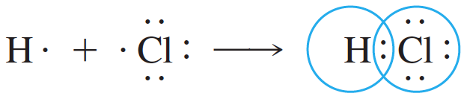
Lewis Formulas
A formula using dots to represent valence electrons is called a Lewis electron-dot formula. An electron pair represented by a pair of dots in such a formula is either a bonding pair (an electron pair shared between two atoms) or a lone, or nonbonding, pair (an electron pair that remains on one atom and is not shared).

Slide 11
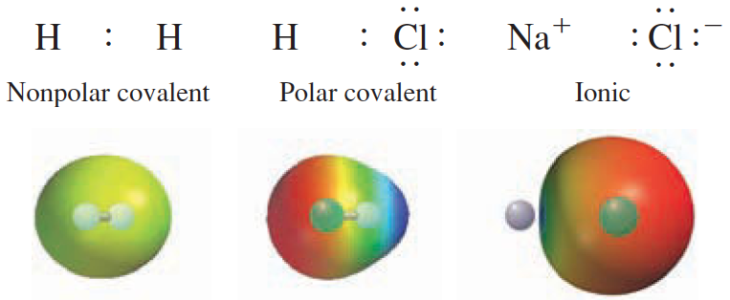
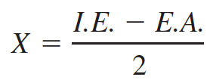
Polar Covalent Bonds; Electronegativity
A polar covalent bond (or simply polar bond) is a covalent bond in which the bonding electrons spend more time near one atom than the other.
Electronegativity is a measure of the ability of an atom in a molecule to draw bonding electrons to itself.
Several electronegativity scales have been proposed. In 1934 Robert S. Mulliken suggested on theoretical grounds that the electronegativity (X) of an atom be given as:

Slide 12
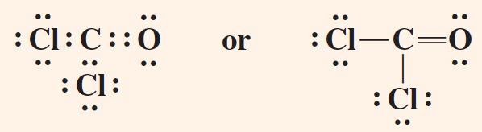
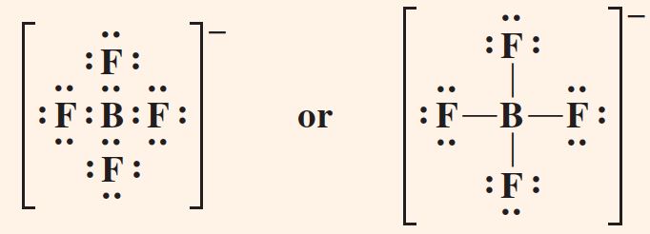
Octet Rule
The tendency of atoms in molecules to have eight electrons in their valence shells (two for hydrogen atoms) is known as the octet rule.
Lewis formula or electron – dot formula

Slide 13
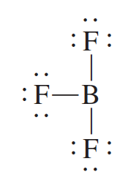
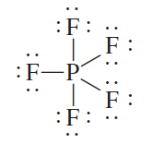
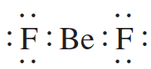
Exception to the Octet Rule
The tendency of atoms in molecules to have eight electrons in their valence shells (two for hydrogen atoms) is known as the octet rule.
and a lot more…..

Slide 14
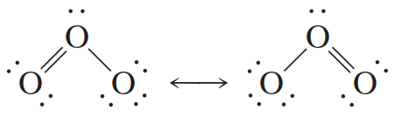
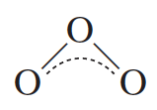
Delocalized Bonding: Resonance
delocalized bonding is a type of bonding in which a bonding pair of electrons is spread over a number of atoms rather than localized between two.
The electron structure of a molecule having delocalized bonding is described by writing all possible electron-dot formulas
We might symbolically describe the delocalized bonding in ozone as follows:

Slide 15
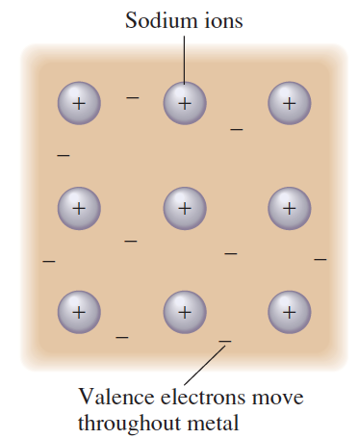
Metals: Extreme Examples of Delocalized Bonding
Metal can be regarded as an array of metal ions surrounded by a “sea” of electrons. The valence, or bonding, electrons are delocalized over the entire metal crystal.
The freedom of these electrons to move throughout the crystal is responsible for the electrical conductivity of a metal.

Slide 16
Bond Length and Bond Order
Bond length (or bond distance) is the distance between the nuclei in a bond. Bond lengths are determined experimentally using x-ray diffraction or the analysis of molecular spectra.
The bond order, defined in terms of the Lewis formula, is the number of pairs of electrons in a bond. For example, in C : C the bond order is 1 (single bond); in C : : C the bond order is 2 (double bond).
Bond length depends on bond order. As the bond order increases, the bond strength increases and the nuclei are pulled inward, decreasing the bond length.
The average C – C bond length is 154 pm, whereas C=C is 134 pm long and CΞC is 120 pm long.

Slide 17
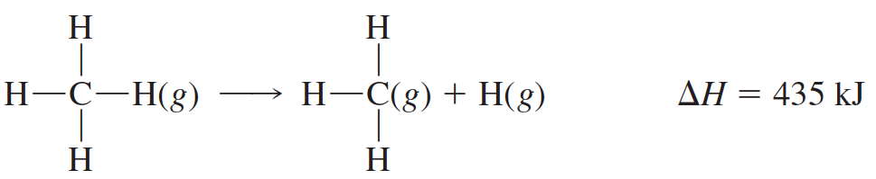
Bond Energy
The bond dissociation energy is a measure of the strength of a particular bond and is essentially the enthalpy change for a gas-phase reaction in which a bond breaks.
We define the A–B bond energy as the average enthalpy change for the breaking of an A–B bond in a molecule in the gas phase. For example, to calculate a value for the C–H bond energy, you might look at the experimentally determined enthalpy change for the breaking of all the C–H bonds in methane:
The average value for breaking one C–H bond is its bond energy
BE(C–H) = 1662/4 kJ = 416 kJ

Slide 18
Molecular Geometry and Chemical Bonding Theory
Molecular Geometry and Directional Bonding - The Valence-Shell Electron-Pair Repulsion (VSEPR) Model - Dipole Moment and Molecular Geometry - Valence Bond Theory - Description of Multiple Bonding
Molecular Orbital Theory - Principles of Molecular Orbital Theory - Electron Configurations of Diatomic Molecules of the Second-Period Elements
- Molecular Orbitals and Delocalized Bonding

Slide 19
The Valence-Shell Electron-Pair Repulsion (VSEPR) Model
The VSEPR model predicts the shapes of molecules and ions by assuming that the valence-shell electron pairs are arranged about each atom so that electron pairs are kept as far away from one another as possible, thus minimizing electron-pair repulsions.
If there are only two electron pairs in the valence shell of an atom, these pairs tend to be at opposite sides of the nucleus, so that repulsion is minimized. This gives a linear arrangement of electron pairs; that is, the electron pairs mainly occupy regions of space at an angle of 180° to one another
If three electron pairs are in the valence shell of an atom, they tend to be arranged in a plane directed toward the corners of a triangle of equal sides. This arrangement is trigonal planar, in which the regions of space occupied by electron pairs are directed at 120° angles to one another

Slide 20
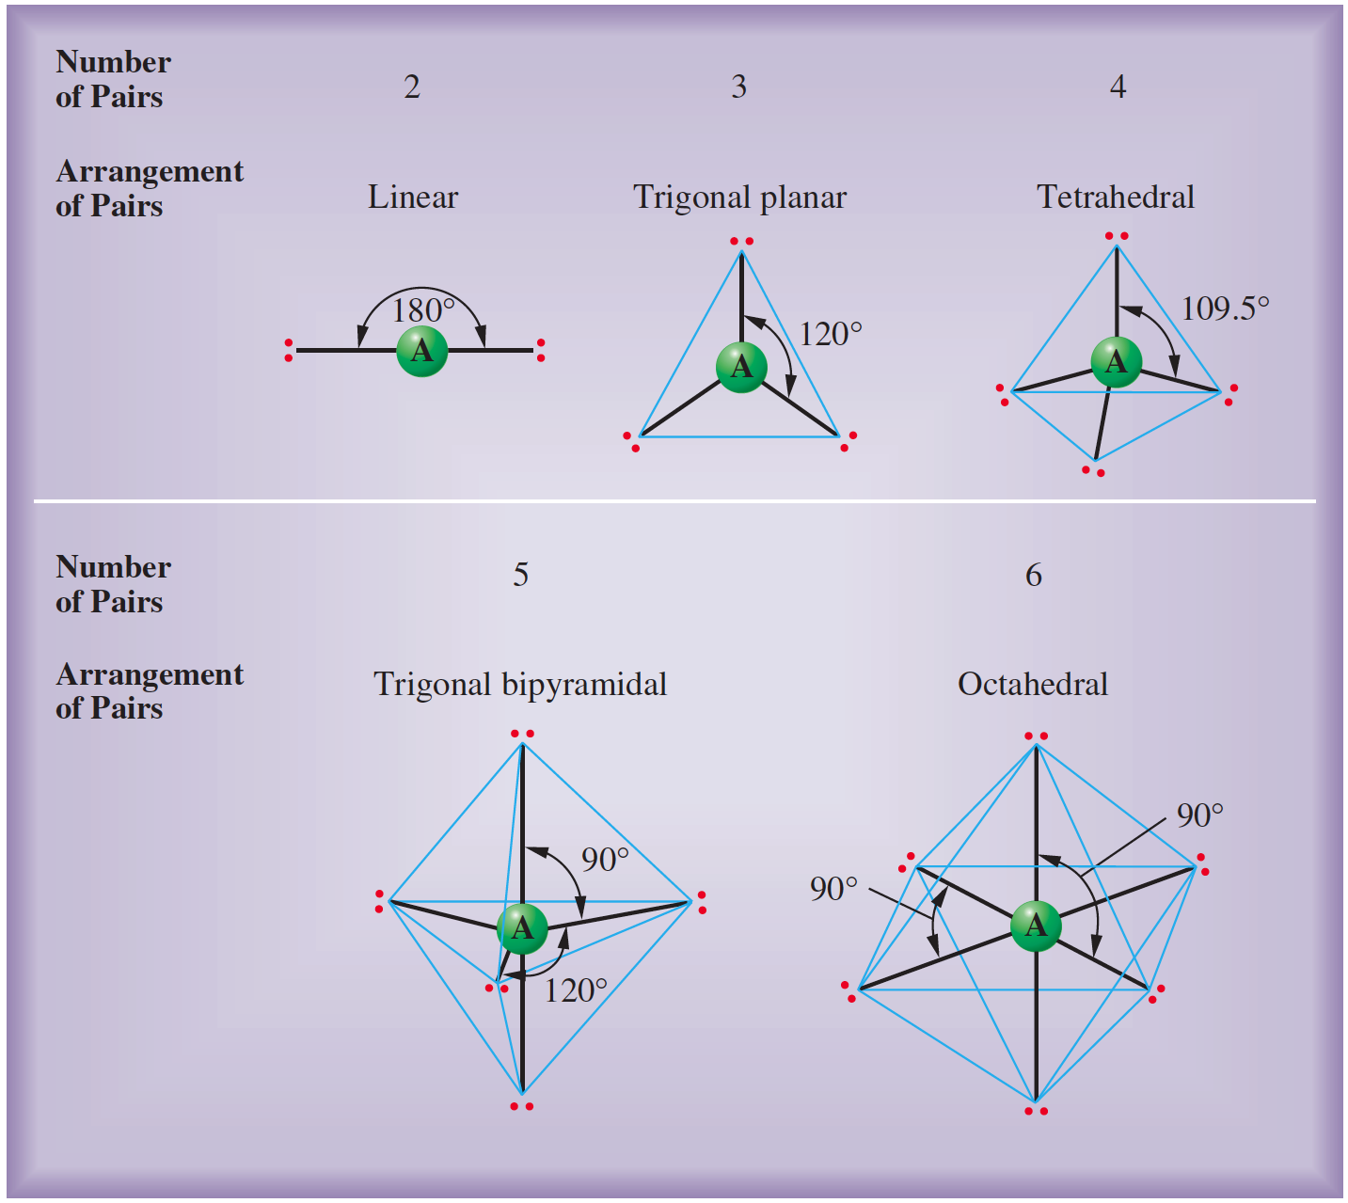
Arrangement of Electron Pairs About an Atom

Slide 21
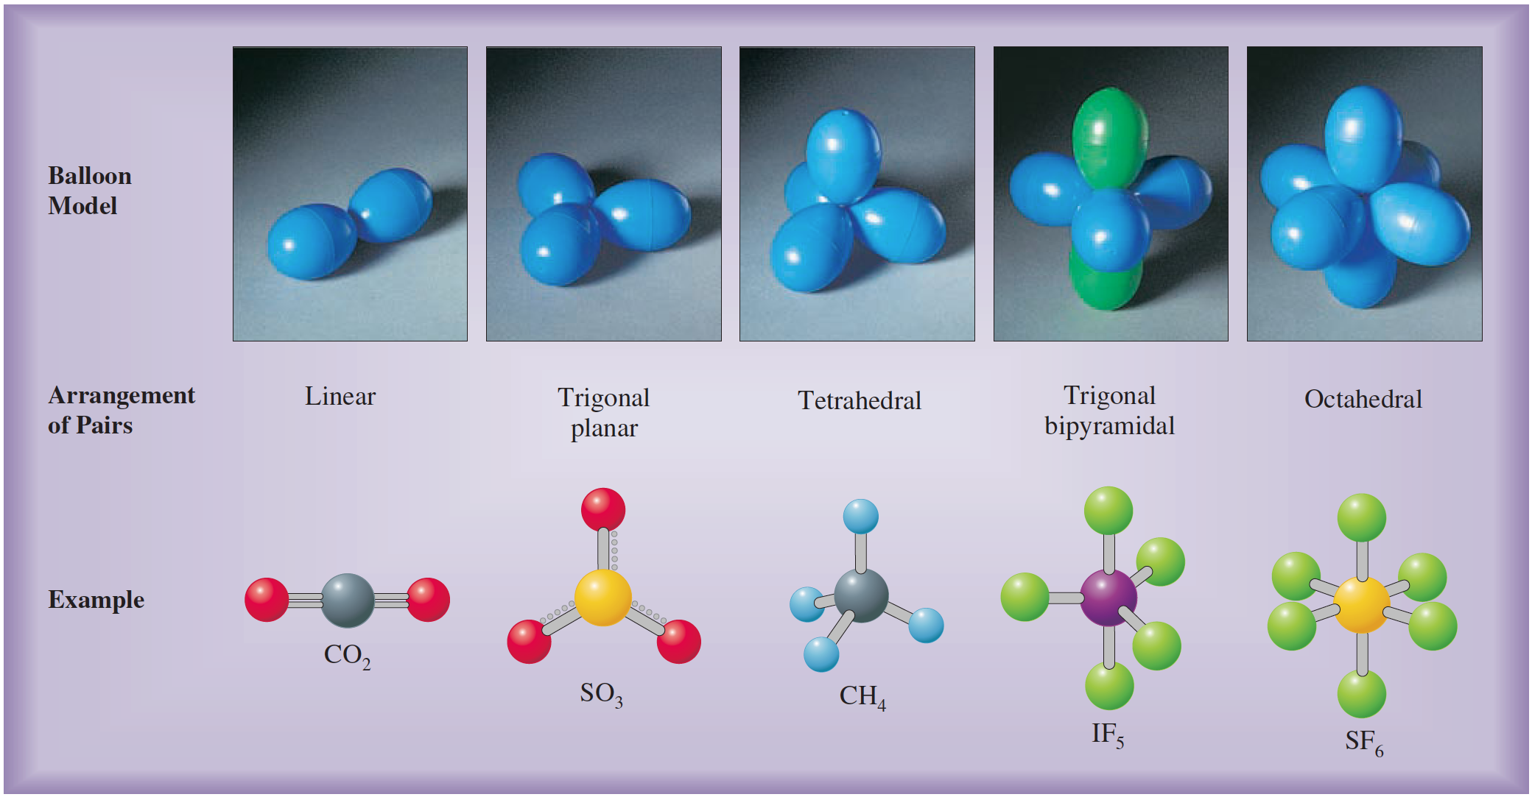
Arrangement of Electron Pairs About an Atom

Slide 22
Steps in the Prediction of Geometry by the VSEPR Model
Step 1: Write the electron-dot formula from the molecular formula.
Step 2: Determine from the electron-dot formula the number of electron pairs around the central atom, including bonding and nonbonding pairs. (Count a multiple bond as one pair. If resonance occurs, use one resonance formula to determine this number.)
Step 3: Determine the arrangement of these electron pairs about the central atom.
Step 4: Obtain the molecular geometry from the directions of the bonding pairs for this arrangement.

Slide 23
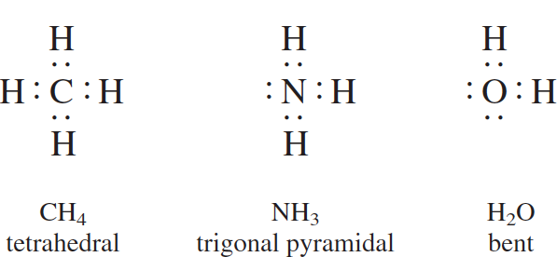
Tetrahedral Arrangement
Possible three different molecular geometries

Slide 24
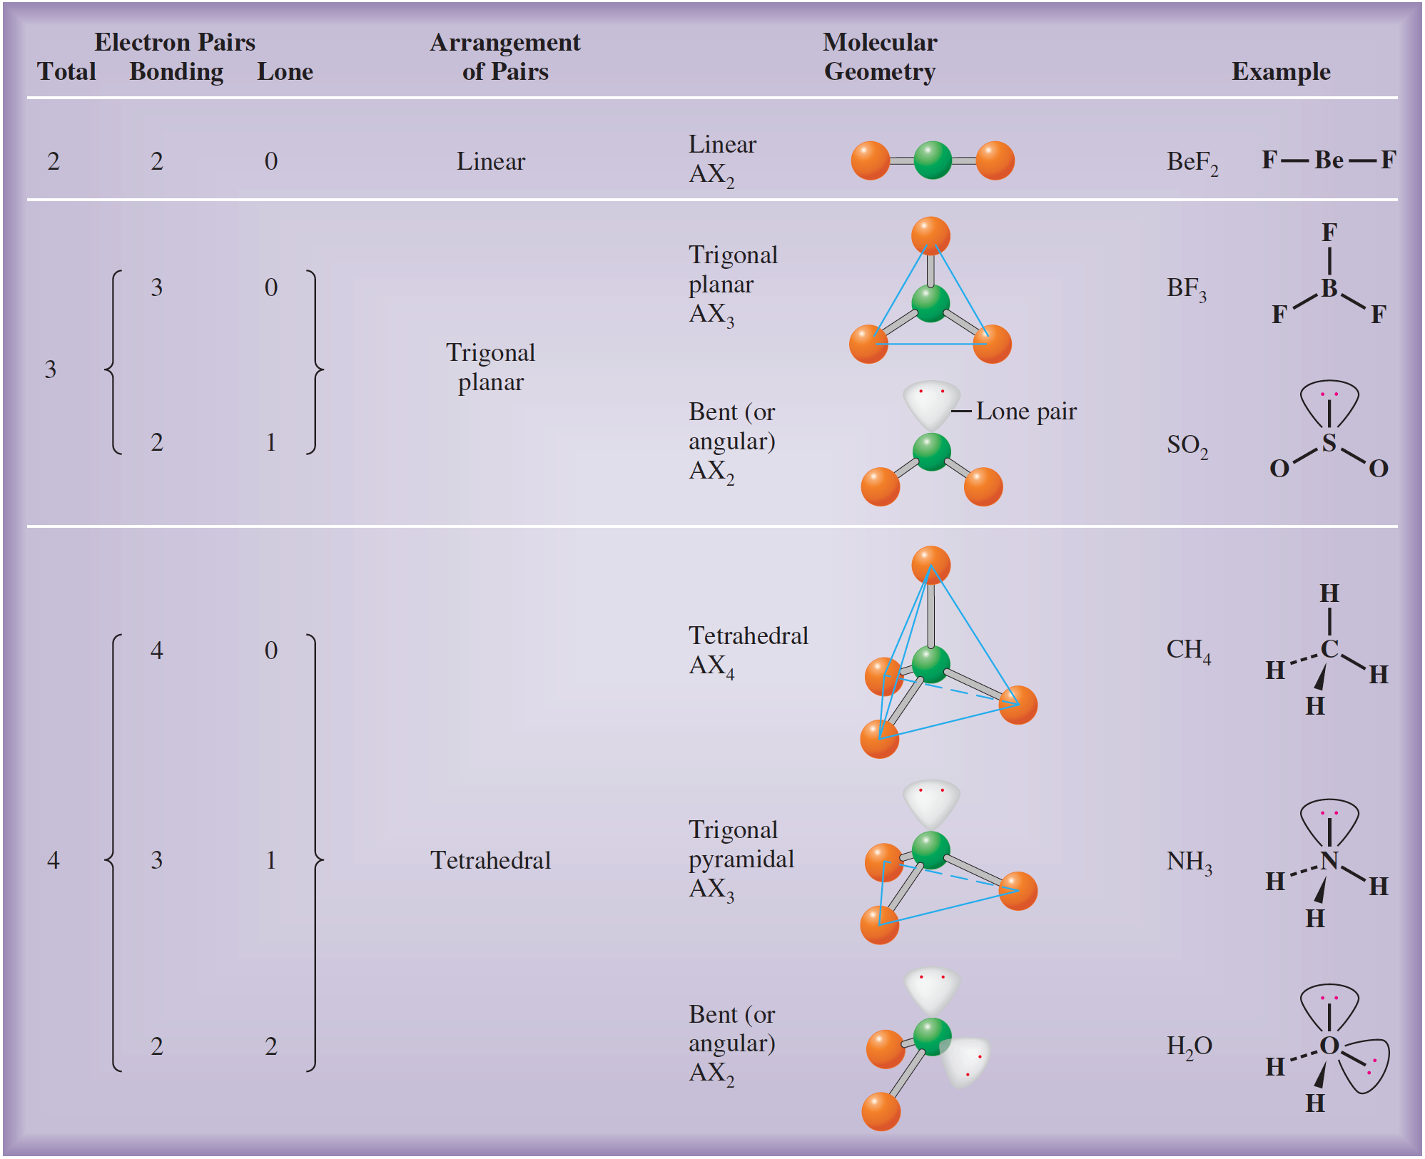

Slide 25
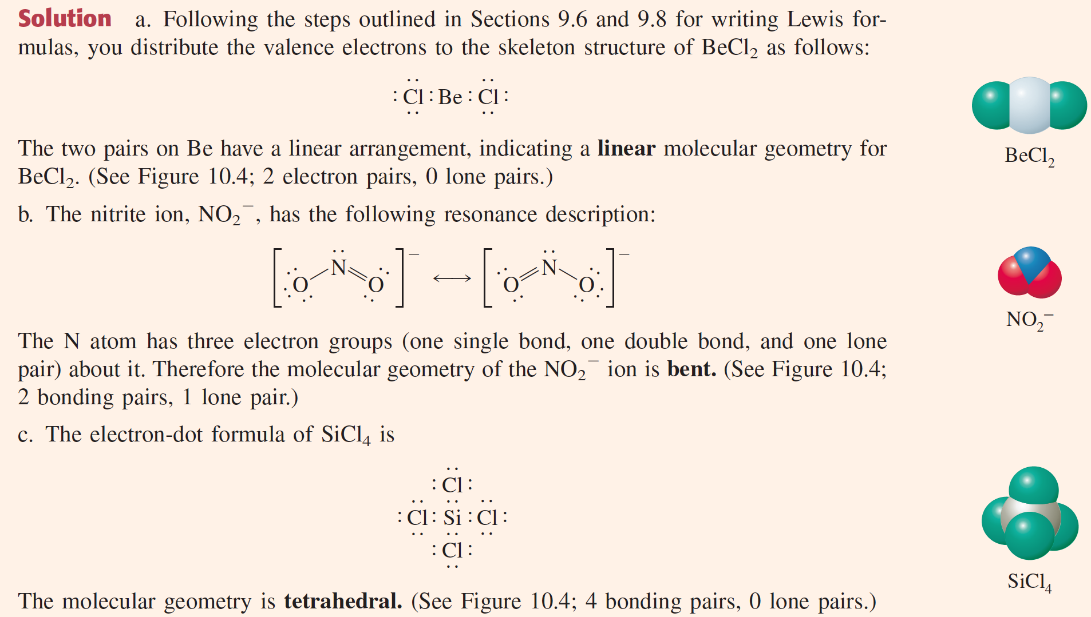
Predicting Molecular Geometries
Predict the geometry of the following molecules or ions, using the VSEPR method: a. BeCl₂ b. NO₂ c. SiCl₄.

Slide 26
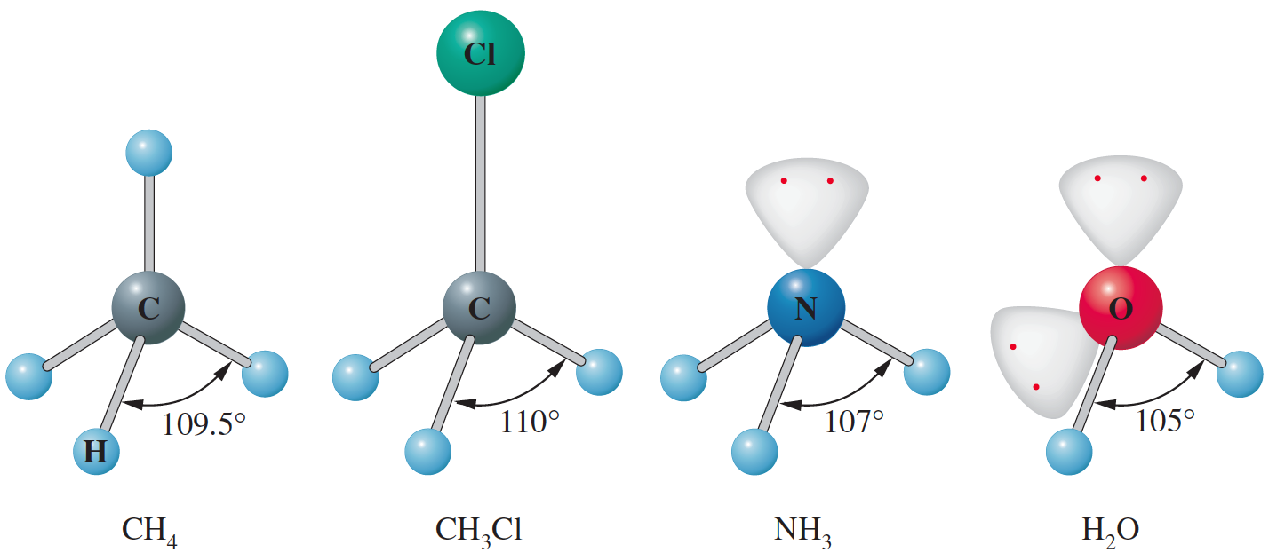
Bond Angles and the Effect of Lone Pairs
A lone pair tends to require more space than a corresponding bonding pair. A lone pair of electrons is attracted to only one atomic core, whereas a bonding pair is attracted to two. As a result, the lone pair is spatially more diffuse, while the bonding pair is drawn more tightly to the nuclei. In NH3 molecule, the lone pair on the nitrogen atom requires more space than the bonding pairs. Therefore, the N–H bonds are effectively pushed away from the lone pair, and the H–N–H bond angles become smaller (107°) than the tetrahedral value of 109.5°.

Slide 27
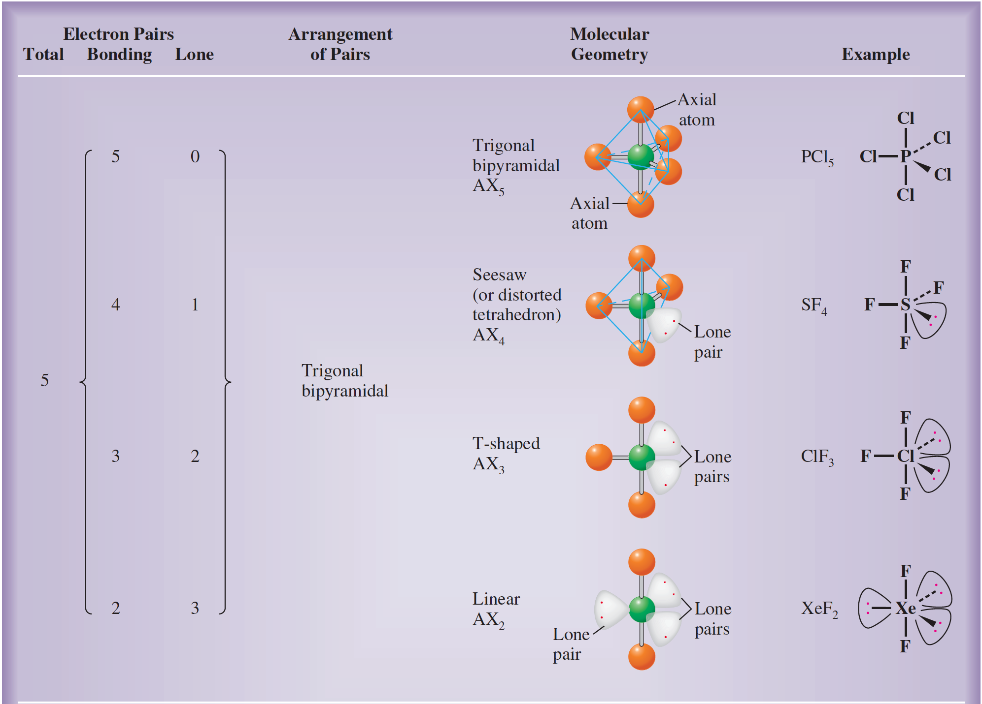
Central Atom with Five Valence-Shell Electron Pairs

Slide 28
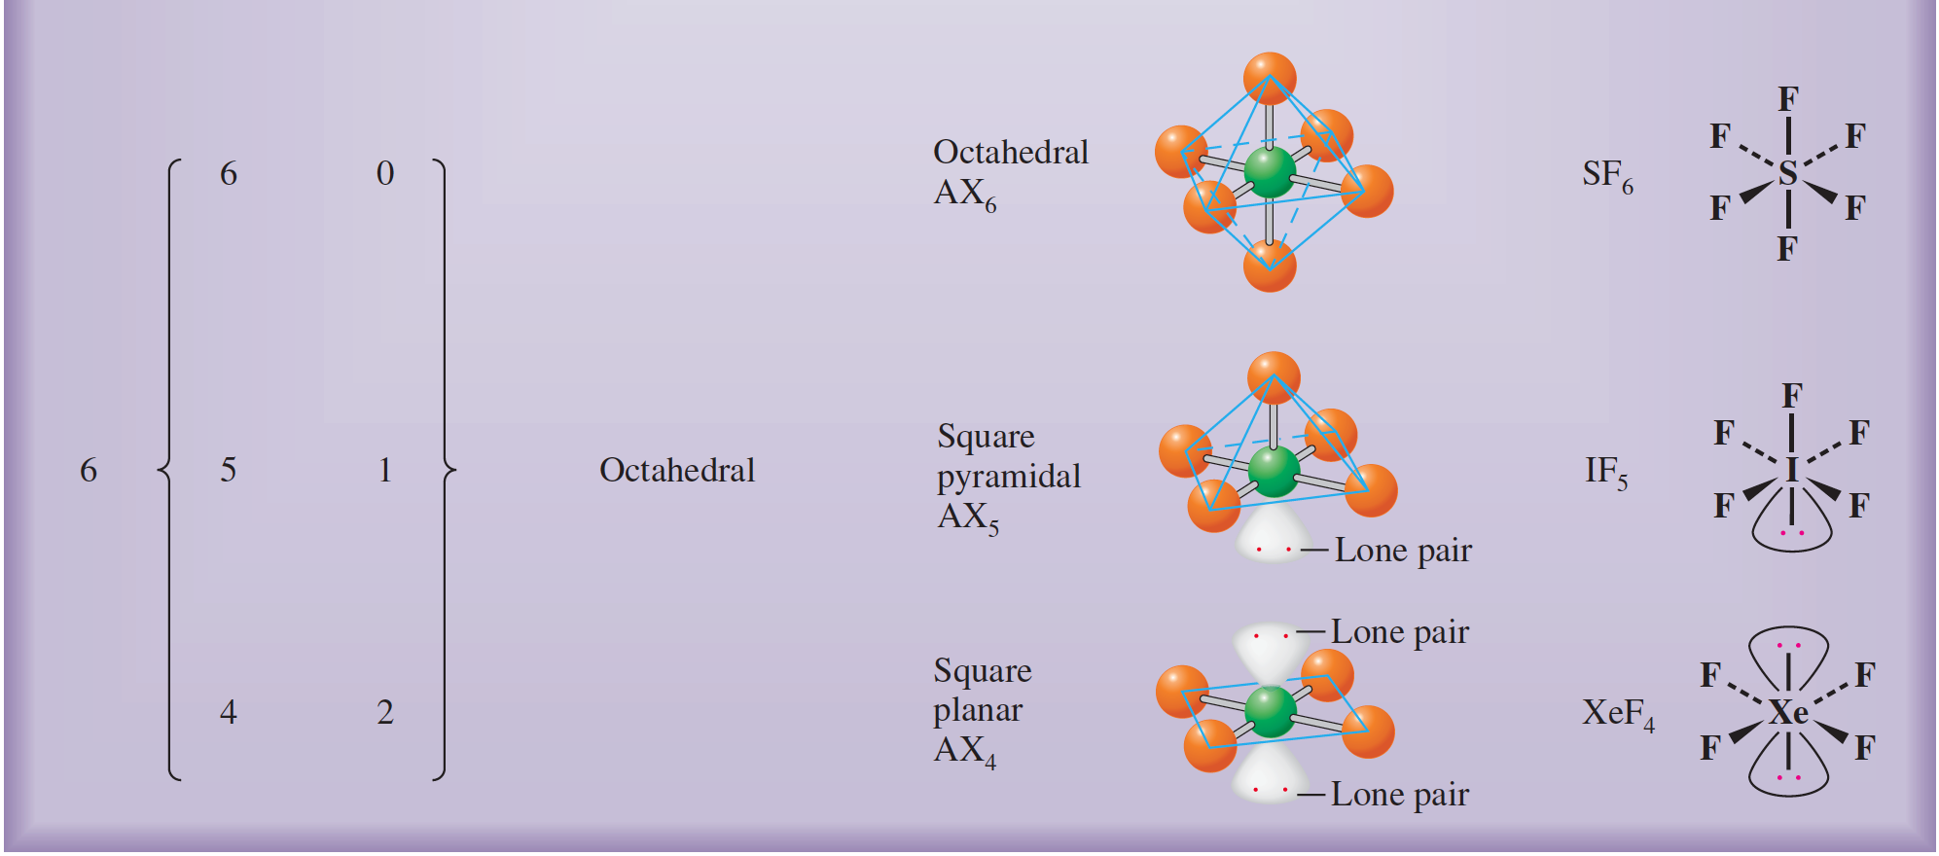
Central Atom with Six Valence-Shell Electron Pairs

Slide 29
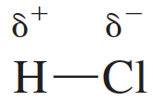
Dipole Moment and Polarity of Bond
The dipole moment is a quantitative measure of the degree of charge separation in a molecule.
The polarity of a bond, such as that in HCl, is characterized by a separation of electric charge.
A molecule in which the distribution of electric charge is equivalent to charges +δ and –δ separated by a distance d has a dipole moment equal to qδ.
Diplole moments are usually measured in units of debyes (D).
In SI units, dipole moments are measured in coulomb-meters (C.m), and 1 D = 3.34 × 10^{–30} C.m.

Slide 30
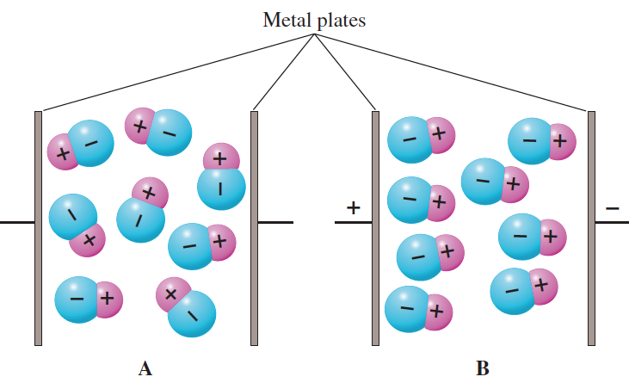
Alignment of Polar Molecules by an Electric Field
(A) A polar substance is placed between metal plates.
(B) When the plates are connected to an electric voltage (whose direction is shown by the + and – signs), the polar molecules align so that their negative ends point toward the positive plate.

Slide 31
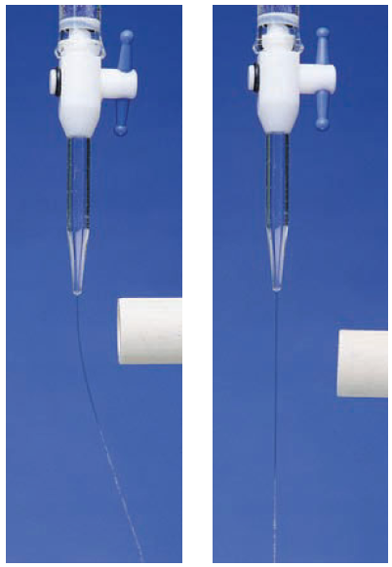
Attraction of a Polar Liquid to an Electrified Rod
Left: Water is a polar liquid; it is attracted to the electrically charged rod. Charges of signs opposite to
those on the rod form on the liquid surface near the rod, resulting in a net attraction.
Right: Carbon tetrachloride, CCl4, is a nonpolar liquid; it is not attracted to the glass rod.

Slide 32
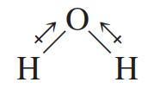
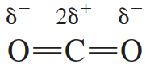
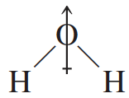
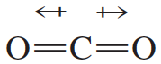
Relationship Between Molecular Geometry and
Dipole Moment
net dipole moment = zero
net dipole moment = 1.94 D

Slide 33
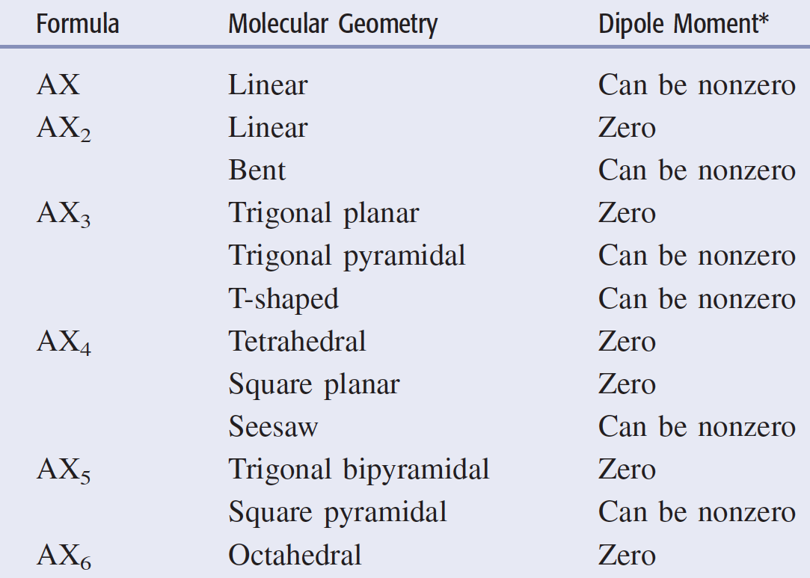
Relationship Between Molecular Geometry and
Dipole Moment

Slide 34
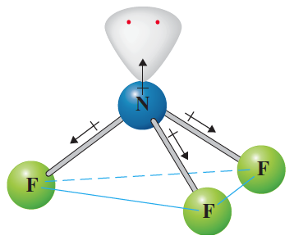
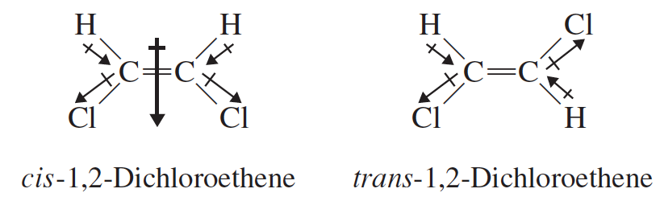
Dipole Moment and Polarity of Bond
Can you explain why NH₃ has such a large dipole moment compared with NF₃?
Can you explain why cis-1,2-dichloroethane has a large dipole moment, whereas trans-1,2-dichloroethane has zero diploe moment?

Slide 35
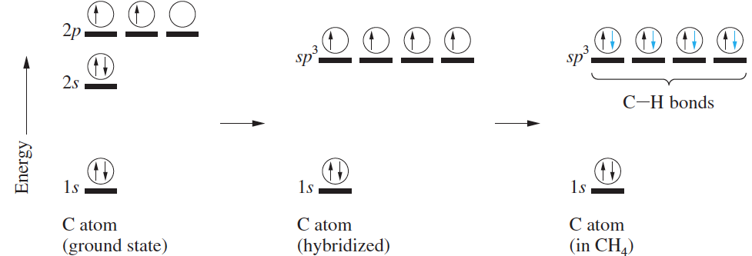
Valence Bond Theory
Valence Bond Theory (VBT) is an approximate theory to explain the electron pair or covalent bond by quantum mechanics.
Hybrid orbitals are orbitals used to describe bonding that are obtained by taking combinations of atomic orbitals of the isolated atoms.
Hybrid orbitals can be formed from various numbers of atomic orbitals. The number of hybrid orbitals formed always equals the number of atomic orbitals used.

Slide 36
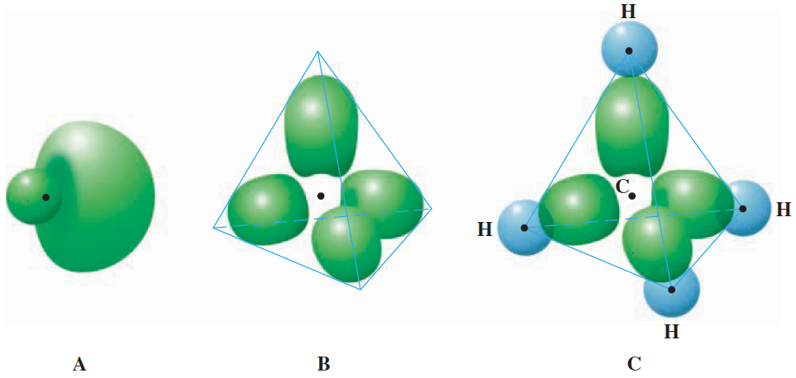
Spatial Arrangement of sp³
Hybrid Orbitals
(A) The shape of a single sp³ hybrid orbital. Each orbital consists of two lobes. One lobe is small, but dense, and concentrated near the nucleus. The other lobe is large, but diffuse. Bonding occurs with the large lobe, since it extends further from the nucleus. (B) The four hybrid orbitals are arranged tetrahedrally in space. (Small lobes are omitted here for clarity) (C) Bonding in CH₄. Each C–H bond is formed by the overlap of a 1s orbital from a hydrogen atom and an sp³ hybrid orbital of the carbon atom.

Slide 37
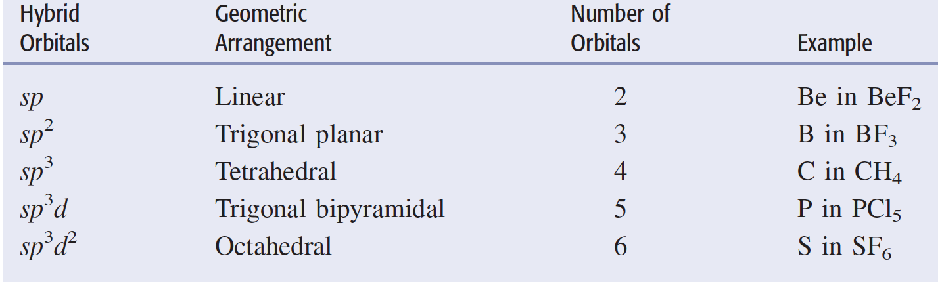
Kinds of Hybrid Orbitals

Slide 38
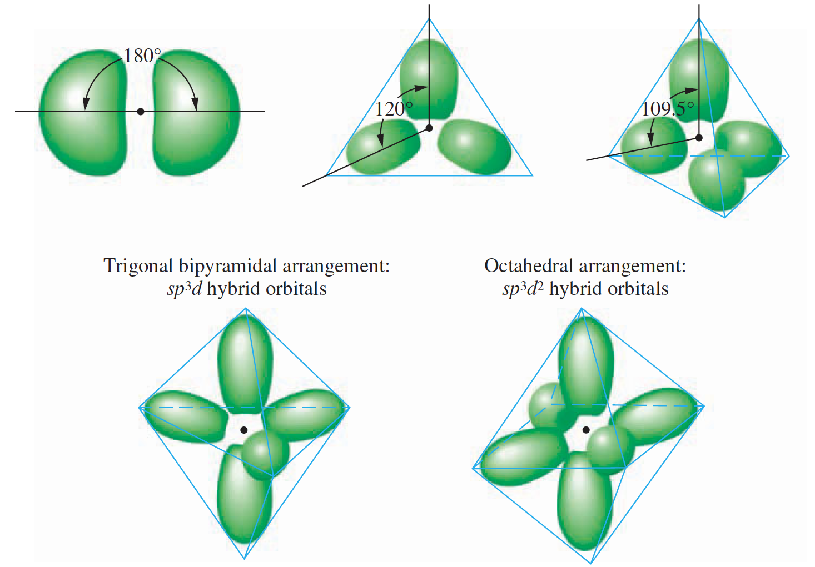
Kinds of Hybrid Orbitals

Slide 39
Applying Valence Bond Theory
Step 1: Write the Lewis electron-dot formula of the molecule.
Step 2: From the Lewis formula, use the VSEPR model to obtain the arrangement of electron pairs about this atom.
Step 3: From the geometric arrangement of the electron pairs, deduce the type of hybrid orbitals on this atom required for the bonding description.
Step 4: Assign valence electrons to the hybrid orbitals of this atom one at a time, pairing them only when necessary.
Step 5: Form bonds to this atom by overlapping singly occupied orbitals of other atoms with the singly occupied hybrid orbitals of this atom.

Slide 40
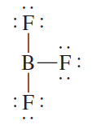
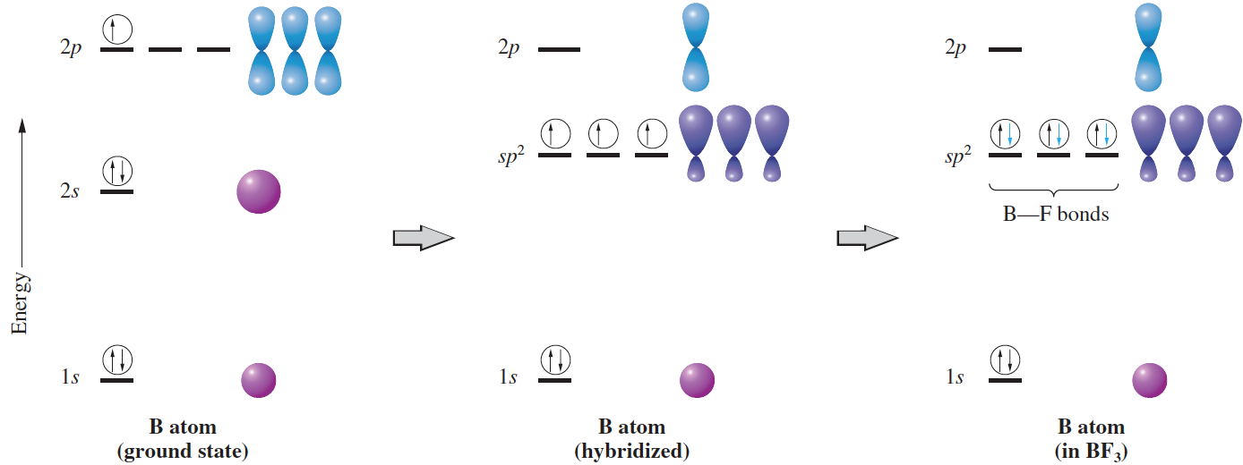
Applying Valence Bond Theory

Slide 41

Applying Valence Bond Theory

Slide 42


Slide 43


Description of Multiple Bonding
One hybrid orbital is needed for each bond (whether a single or a multiple bond) and for each lone pair.

Slide 44

σ Bond and π Bond
(A) The formation of a σ bond by the overlap of two s orbitals.
(B) A σ bond can also be formed by the overlap of two
p orbitals along their axes.
(C) When two p orbitals overlap sideways, a π
bond is formed.

Slide 45

Bonding in Ethylene
(A) The σ-bond framework in ethylene, formed by the overlap of sp² hybrid orbitals on C atoms and 1s orbitals on H atoms.
(B) The formation of the π bonds in ethylene. When the 2p orbitals are perpendicular to one another, there is no overlap and no bond formation. When the two –CH₂ groups rotate so that the 2p orbitals are parallel, a π bond forms.

Slide 46



Slide 47
Molecular Orbital Theory
Simple valence bond theory satisfactorily describes most of the molecules we encounter, it does not apply to all molecules.
According to this theory any molecule with an even number of electrons should be diamagnetic, because we assume the electrons to be paired and to have opposite spins. In fact, a few molecules with an even number of electrons are paramagnetic, indicating that some of the electrons are not paired. The best-known example of such a paramagnetic molecule is O₂.
Molecular Orbital Theory (MOT) is a theory of the electronic structure of molecules in terms of molecular orbitals, which may spread over several atoms or the entire molecule. This theory views the electronic structure of molecules to be much like the electronic structure of atoms. Each molecular orbital has a definite energy. To obtain the ground state of a molecule, electrons are put into orbitals of lowest energy, consistent with the Pauli exclusion principle, just as in atoms.

Slide 48

Paramagnetism of Oxygen
Liquid oxygen is poured between the poles of a strong magnet. Oxygen adheres to the poles, showing that it is paramagnetic.

Slide 49

Bonding and Antibonding Orbitals
Molecular orbitals that are concentrated in regions between nuclei are called bonding orbitals.
Molecular orbitals having zero values in the region between two nuclei and therefore concentrated in other regions are called antibonding orbitals.

Slide 50



MOT – H₂ Molecule

Slide 51



Bond Order
The term bond order refers to the number of bonds that exist between two atoms.
In molecular orbital theory, the bond order of a diatomic molecule is defined as one-half the difference between the number of electrons in bonding orbitals, n_{b}, and the number
of electrons in antibonding orbitals, n_{a}
For H₂ Molecule,
For He₂ Molecule,

Slide 52


MOT – He₂ Molecule

Slide 53


The different ways in which 2p orbitals can interact
The order of filling is,

Slide 54


Slide 55



Slide 56

Bond Order

